Slide 1



Presentation on Android
Submitted by :-
Davansh Bhardwaj
Pallavi Ramawat
Payal Bohra
Yogesh Sharma
Abhishek Pratap Singh
Under Guidance:-
Maninder Singh Bhui ;
Er . Pankaj Gupta

Slide 2
What is Android ?
Android is the name of the mobile operating system owned by American company; Google. It most commonly comes installed on a variety of smart phones and tablets from a host of manufacturers offering users access to Google’s own services like Search, YouTube, Maps, Gmail and more.
This means you can easily look for information on the web, watch videos, search for directions and write emails on your phone, just as you would on your computer, but there’s more to Android than these simple examples.

Slide 3
List of Version’s in Android
version 1.5 Cupcake
version 1.6 Donut
version 2.0-2.1 Éclair
version 2.2-2.2.3 Froyo
version 23-237 Gingerbread
version 3.0-3.2.6 Honeycomb
version 4.0-4.0.4 Ice Cream Sandwich,
version 4.1-4.3.1 Jelly Bean
version 4.4.-4.4.4 Kit Kat
version 5.0-5.1.1 Lollipop
version 6.0-6.0.1 Mash mallow
version 7.0 Nougat

Slide 4


Slide 5
What apps can I get on an Android phone?
There are millions of apps and games available to download from the Google Play store.
You can download app like :-
New letter’s
Game’s
Book’s
Software’s
Entertainment Channel’s

Slide 6

Where We Can Find CEG App?
You can find CEG app on google play store and as well as on this link

Slide 7
What is CEG app?
CEG app is basically an application in which students can register themselves in the various courses of this institute.
By this application students can also register for the placements.
They can get the information about the IGNOU courses and their exams.

Slide 8
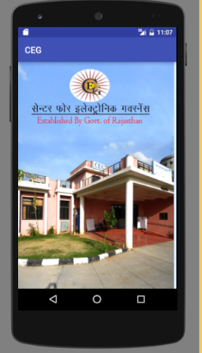
Splash screen
This is the splash screen. This is the first activity of our project which exist for 3 sec.
This splash screen is the first screen of our project.

Slide 9
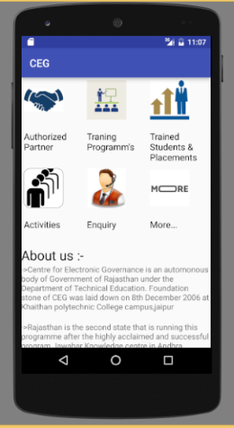
Main screen
This is the second activity of our project in which student can see the main features of the application.

Slide 10
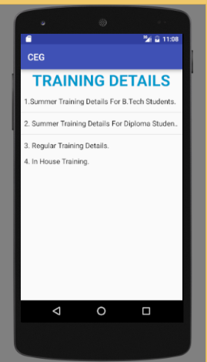
Training Details
In this activity the student will get the information about summer training provided by the institute.

Slide 11

IGNOU COURSES
In this activity the students will get the details about the IGNOU courses and other details.

Slide 12

PARTNERS
CEG collaborates with various companies to provide certification of courses.

Slide 13
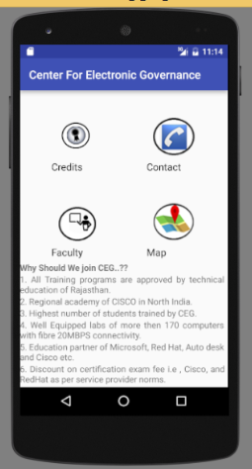
MORE…….
The more details about the institute, faculty and contact details.

